Slide 1

AI for developers: Making your application smarter with Azure AI Services.

Slide 2


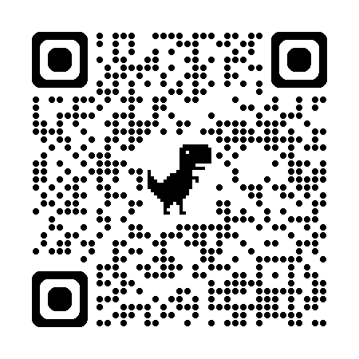

Microsoft MVP.
Client Partner at Geneca.
Spend time with family, movies, videogames, soccer.
Socials
Schedule time with me!

Slide 3
Agenda
Azure AI ecosystem.
Why use Azure AI Services.
Data privacy and security.
Demo.
Sample architectures.

Slide 4
















Azure AI
Applications
Partner Solutions
Business Users
Application Platform
AI Builder
Power BI
Power Apps
Power Automate
Copilot Studio
Scenario-Based Services
Azure AI services
Bot Service
Azure AI Search
Document Intelligence
Video Indexer
Metrics Advisor
Immersive Reader
Customizable AI Models
Azure OpenAI
Service
Azure AI services
Vision
Speech
Language
Decision
Developers & Data Scientists
ML Platform
Azure Machine Learning

Slide 5
Why use AI Services APIs
Simple, targeted approach.
Easy to integrate with available SDKs:
C#
Go
Java
JavaScript
Python
Free tier for multiple services.
Customizable.

Slide 6
Data privacy and security.
Authentication.
Data encrypted at rest and in transit.
Limited access features.
Data storage.
Request data not used to train APIs.
Containers.

Slide 7

DEMO

Slide 8
What will we cover?
Creating a resource.
Testing APIs with studios.
API usage examples.
Vision.
Speech to text.
Language.
Content safety.

Slide 9
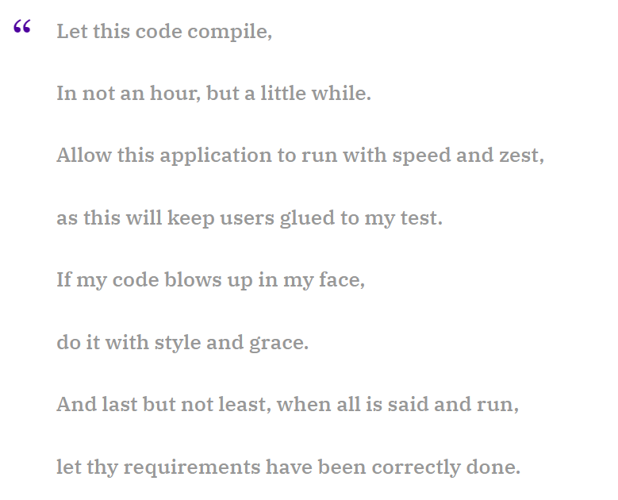
https://www.rambli.com/2016/06/the-prayer-of-the-demo-gods/

Slide 10
SAMPLE ARCHITECTURES

Slide 11
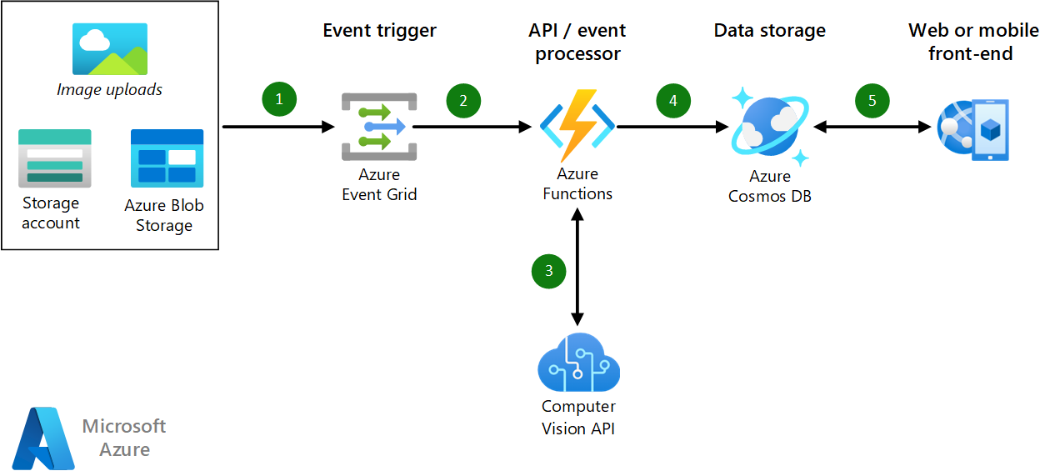
Image classification.

Slide 12






Analyze call center data.
Intelligent transcription
Interact and visualize
Extract insights from call transcripts
Insights in Power BI (Near real-time)
Caller
Extraction
Storage
Enrichment
File upload
Audio files
Azure AI Language
Web app
Telephony server
Azure Blob Storage
Azure Blob Storage
Azure
speech to text
Azure Blob Storage
Azure OpenAI Service
CRM
Call-center agent
Detailed call history, summaries, reasons for calling

Slide 13
Document processing.

Slide 14
Useful links.
https://azure.microsoft.com/en-us/products/ai-services?activetab=pivot:azureopenaiservicetab.
https://ai.azure.com/
https://learn.microsoft.com/en-us/azure/ai-services/responsible-use-of-ai-overview
https://learn.microsoft.com/en-us/credentials/browse/?terms=AI

Slide 15
Useful links.
https://learn.microsoft.com/en-us/azure/architecture/ai-ml/architecture/intelligent-apps-image-processing.

Slide 16
Socials
Schedule time with me!

